Slide 1
Keli Kemeh
Web Tech Fall 2025 Final Exams

Slide 2
Project Description
"I am developing an interactive, web-based inventory management system called Mecha-Lab Manager. This platform helps the Ashesi Engineering Department track common, inexpensive (and expensive) hardware components (such as Arduinos, sensors, and motors). It solves the problem of lost equipment and inefficient manual tracking by providing a digital dashboard where Lab Administrators can manage inventory, and Students can view equipment availability in real-time (and even request it as well…)."

Slide 3
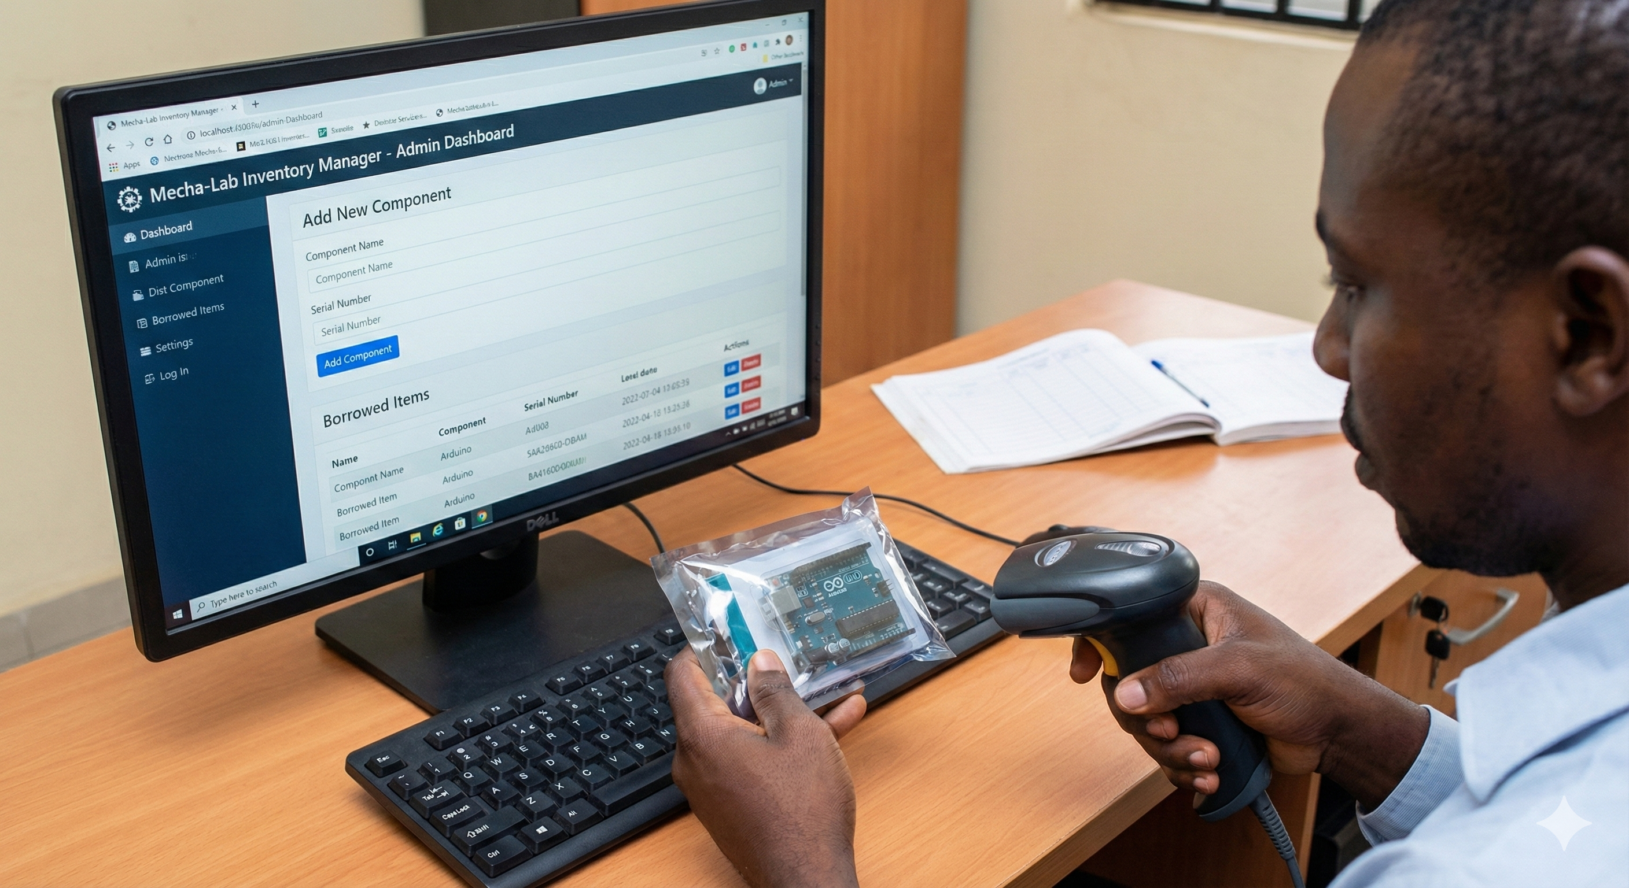

ADMIN ->
<- Student

Slide 4

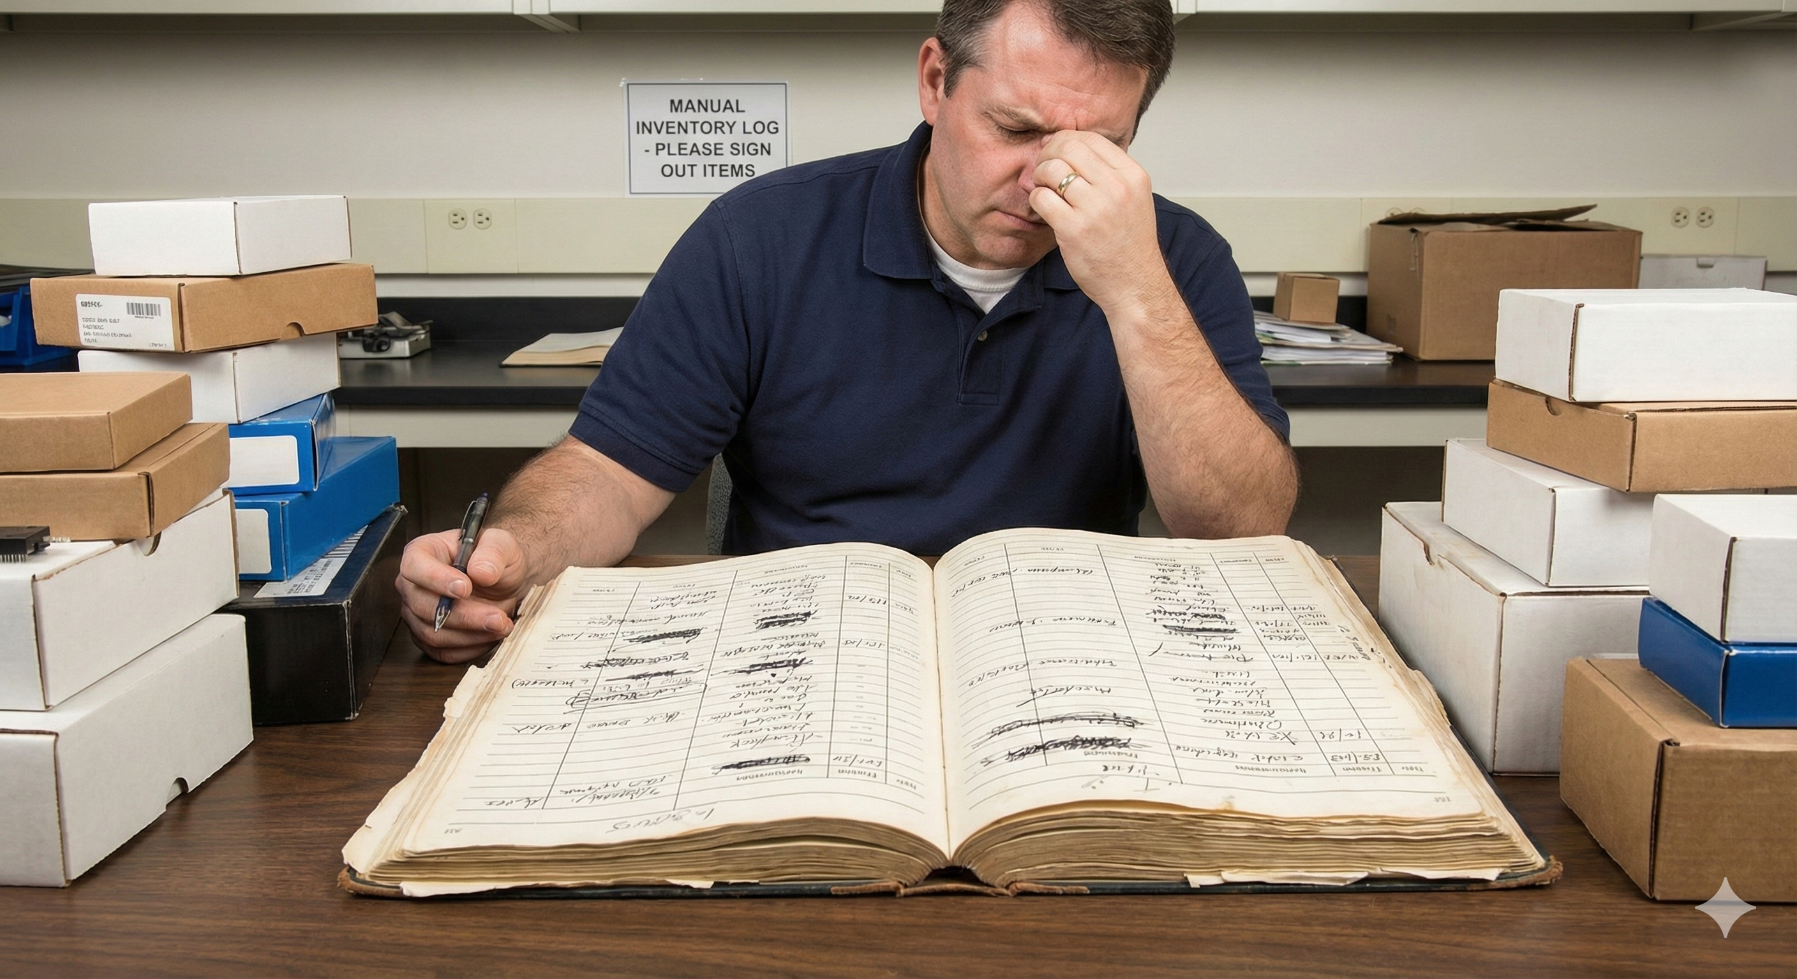
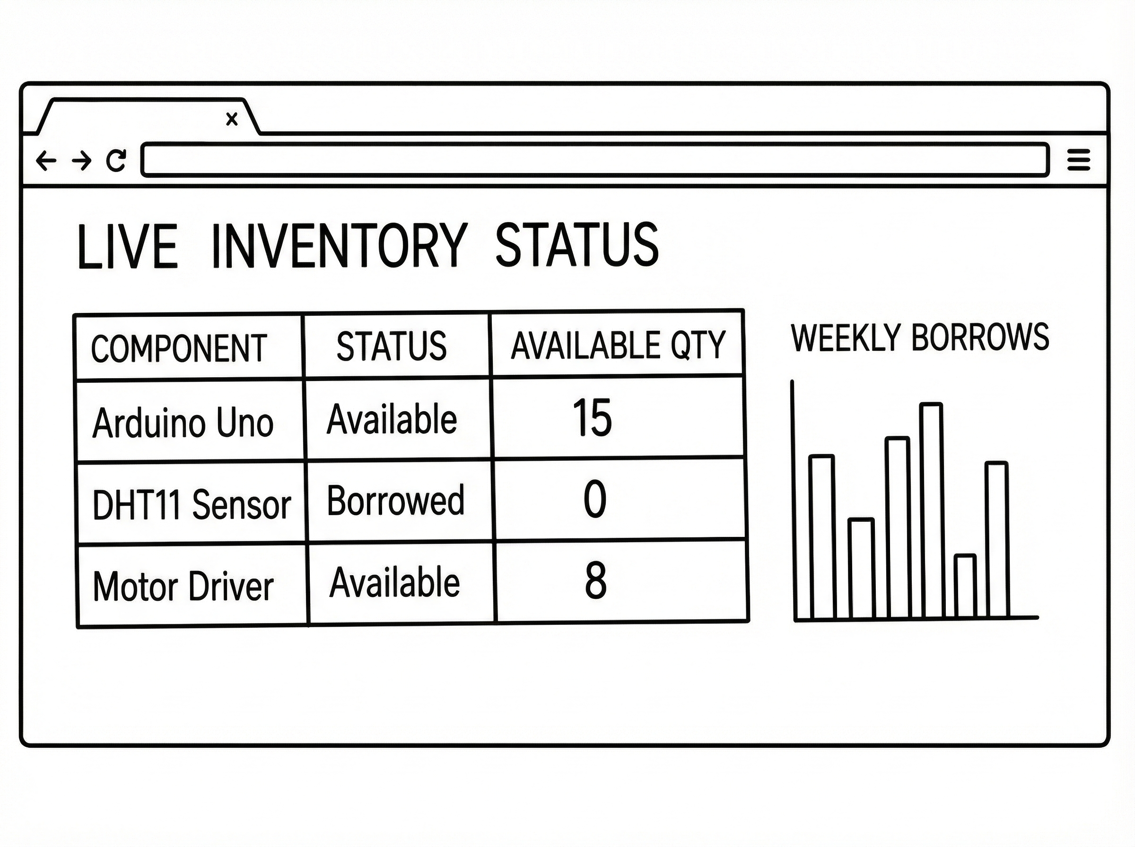
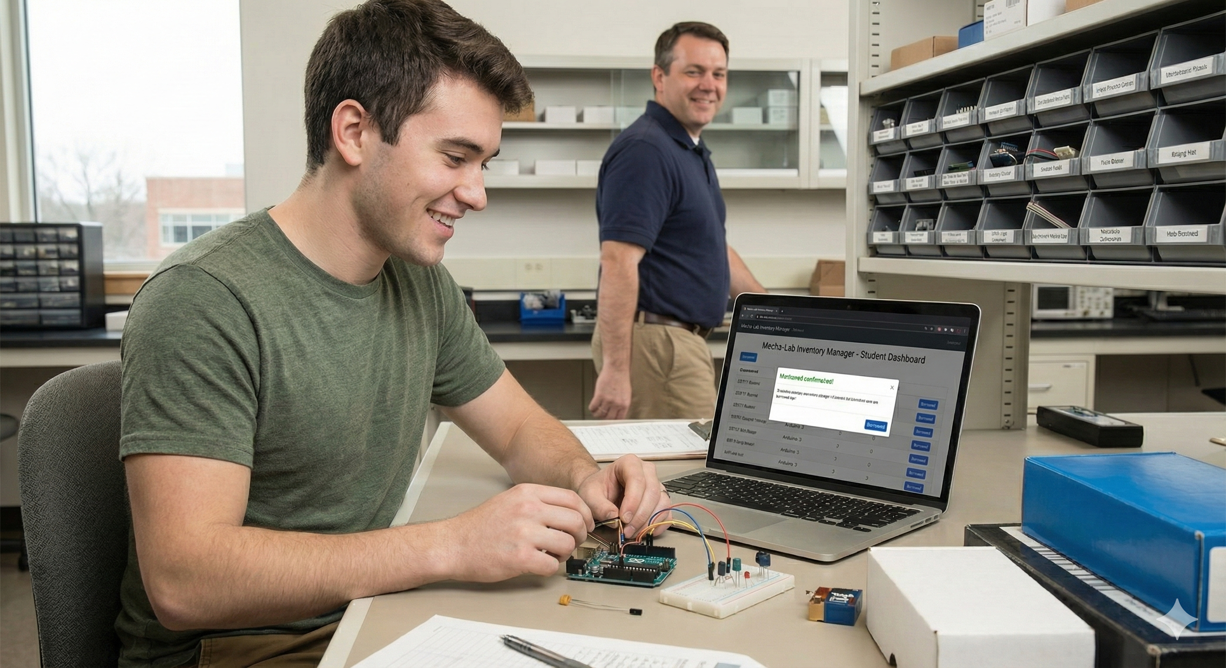
Project Title
ddd
PERSONA(s):
Persona X (The Administrator): “Mr Lockman Tinubu." He needs a way to quickly add new components to the system and see who has borrowed what without checking a paper logbook.
Persona K (The Student): "Keli, 2nd Year CS." He needs to know if a DHT11 Sensor is available before walking all the way to the lab. He also wants to be able to request available components…
PROBLEM:
Currently, the lab relies on physical paper logbooks to track expensive equipment. This creates two significant issues: For Admins, it is difficult to quickly audit inventory or identify who is holding a specific item without manually searching through pages…
For Students: There is no remote visibility. Students must physically walk all the way to the lab to check whether a component (such as a DHT11 Sensor) is available, often wasting time if it is out of stock.
PAYOFF:
The Real-Time Availability Dashboard… The screen displays a live, colour-coded inventory table accessible from anywhere…
What it shows: A clean list of components (e.g., Arduino, Sensors) with their current status ("Available" vs. "Borrowed") and exact stock counts. The Value: Students can instantly see if the parts they need are in stock before leaving their dorms, and Admins can view analytics cards to see total assets at a glance!
FINISH:
Streamlined Access & Accountability… Students utilize their time better by eliminating wasted trips to the lab, ensuring they only go when equipment is confirmed available. Admins gain total control over the inventory with digital records that are easy to update and search, significantly reducing the risk of lost or unaccounted-for equipment compared to the old paper method.

Slide 5
User Roles / Services
Service: Equipment tracking and status management…
User Roles:
Admin: Has complete control. Can Create new items, Update status (mark as broken/lost), and Delete old items (and even approve student’s requests to borrow items…).
Student: Read-only access (initially). Can read the dashboard to see what is available (e.g., "5 Ultrasonic Sensors Available"), and even request what they see on view, with the time span for how long they want to use the equipment for even available…

Slide 6
Main Functions of the Website (CRUD)
Inventory Dashboard: A visual table displaying all lab components with status indicators (Green for Available, Yellow for Borrowed).
Add Component (Create): A form for Admins to register new equipment with unique Serial Numbers.
Status Updates (Update): A mechanism to change an item's status when it is checked out or returned.
Analytics: A chart visualization showing the percentage of broken vs. working equipment.

Slide 7
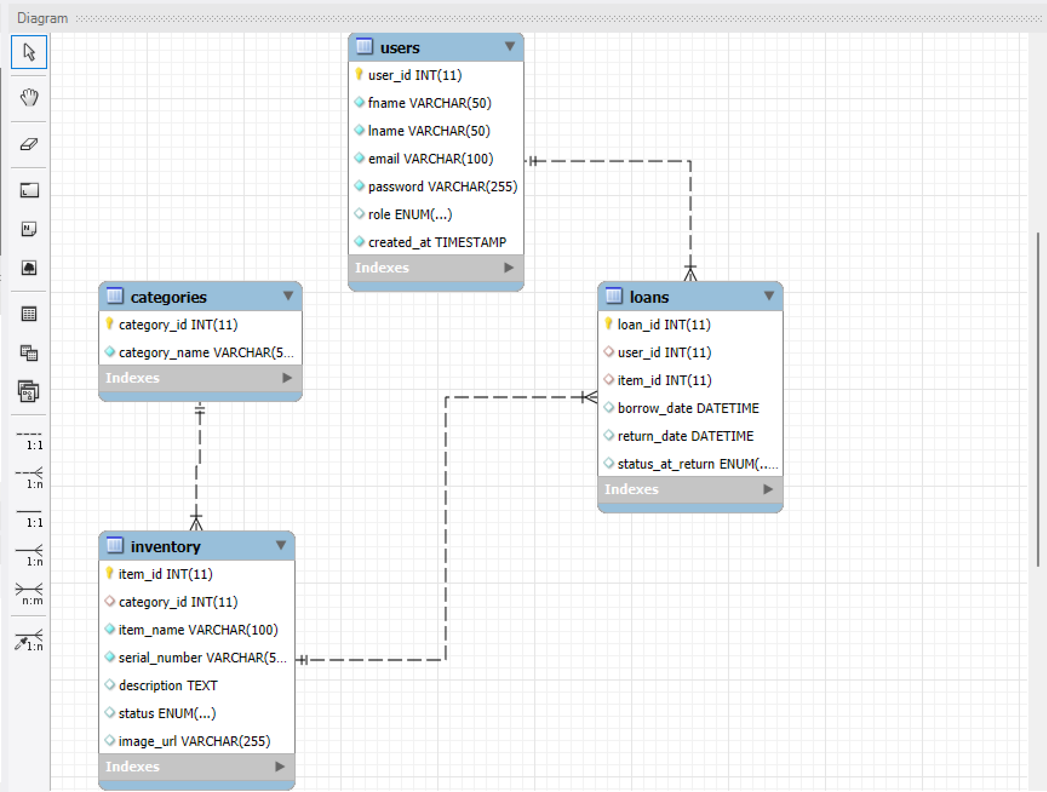
Architecture
PRESENTATION TIER HTML5 CSS (Bootstrap 5 for responsive design) JAVASCRIPT (Chart.js for analytics) Responsive design! | APPLICATION TIER PHP (Backend logic) AUTHENTICATION Regex Validation (Server-side & Client-side ADMIN CONTROLS | DATA TIER MYSQL DATABASE Tables: Users, Categories, Loans, Inventory…

